Slide 1
Joining and Transforming Data in R
11/20/2024
Ian Mbuthia

Slide 2
Joins
Joins add columns from y to x, matching observations based on the keys. There are four mutating joins:
Inner join
Outer join
Left Join
Right Join
Full Join

Slide 3

Inner Join
An inner join only keeps observations from x that have a matching key in y.
The most important property of an inner join is that unmatched rows in either input are not included in the result.
Notes:
Not appropriate for most analyses, due to easy loss of observations (data)

Slide 4
Outer Join
The three outer joins keep observations that appear in at least one of the data frames.
Left join keeps all observations in x.
Right join keeps all observations in y.
Full join keeps all observations in x and y.
Notes:
Not appropriate for most analyses, due to easy loss of observations (data)

Slide 5

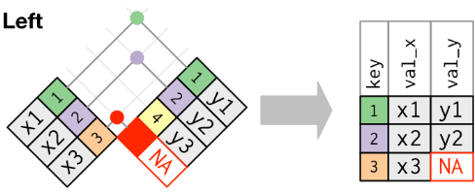
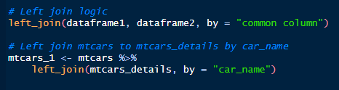
Left Join
Return all rows from x, and all columns from x and y.
Rows in x with no match in y will have NA values in the new columns.
Notes:
If there are multiple matches between x and y, all combinations of the matches are returned.

Slide 6
Exercise
Use the “Import dataset” feature to import the 3 worksheets in the Inventory.xlsx into R as three distinct datasets named Quantity, Location and Description respectively.
Left join the Quantity dataset to the Location dataset using the Item Number.
Notes:
RELATIONSHIPS:
Handling of the expected relationship between the keys of x and y.
"one-to-one" expects:
Each row in x matches at most 1 row in y.
Each row in y matches at most 1 row in x.
"one-to-many" expects:
Each row in y matches at most 1 row in x.
"many-to-one" expects:
Each row in x matches at most 1 row in y.
"many-to-many" doesn't perform any relationship checks, but is provided to allow you to be explicit about this relationship if you know it exists.

Slide 7

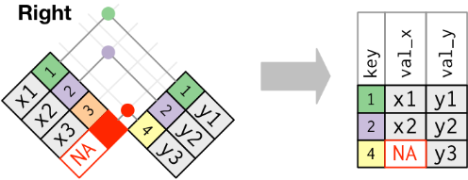
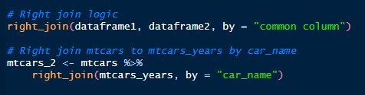
Right Join
Return all rows from y, and all columns from x and y.
Rows in y with no match in x will have NA values in the new columns.
Notes:
Just like the left join, if there are multiple matches between x and y, all combinations of the matches are returned.

Slide 8
Exercise
Right join Location data to Description data using both Item Number and Subinventory Location.
Set the relationship to “many-to-many”.

Slide 9

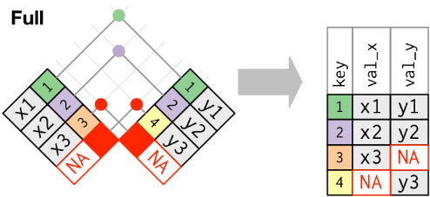
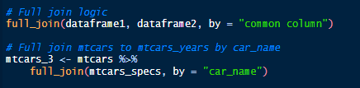
Full Join
Return all rows and all columns from both x and y.
Where there are not matching values, returns NA for the one missing.

Slide 10
Exercise
Create a dataset named fullInventory that will keep all the observations from both the Quantity and Description datasets.
Notes:
RELATIONSHIPS:
Handling of the expected relationship between the keys of x and y.
"one-to-one" expects:
Each row in x matches at most 1 row in y.
Each row in y matches at most 1 row in x.
"one-to-many" expects:
Each row in y matches at most 1 row in x.
"many-to-one" expects:
Each row in x matches at most 1 row in y.
"many-to-many" doesn't perform any relationship checks, but is provided to allow you to be explicit about this relationship if you know it exists.

Slide 11

Transformation
group_by()
It takes a data frame and one or more variables to group by.
.

Slide 12

Transformation
summarise()
computes a summary for each group.

Slide 13
Exercise
Get the total (sum) Quantity for each of Item Number in the Quantity dataset.
Calculate the average weight for Each Inventory Location.

